Slide 1
AI in Healthcare
Assignment 1
Luke Profio

Slide 2
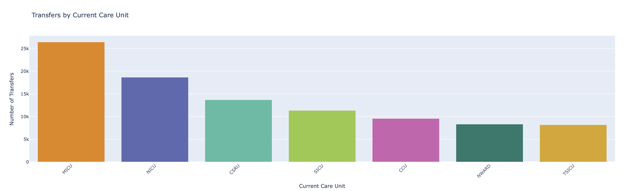
Plot 1 – Transfers by Current Care Unit

Slide 3
Plot 1 – Transfers by Current Care Unit
For this chart, we use the TRANSFERS.csv file.
First, we count how many transfers exist for each care unit.
Then, we plot a vertical bar chart showing the number of transfers for each care unit.
This chart shows which care units have the most patient transfers.

Slide 4
Plot 1 – Transfers by Current Care Unit
transfer_counts = transfers['CURR_CAREUNIT'].value_counts().reset_index()
transfer_counts.columns = ['care_unit', 'count']
fig1 = px.bar(
transfer_counts,
x='care_unit',
y='count',
color='care_unit',
title='Transfers by Current Care Unit',
color_discrete_sequence=px.colors.qualitative.Vivid
)
fig1.update_layout(
xaxis_title='Current Care Unit',
yaxis_title='Number of Transfers',
showlegend=False,
xaxis_tickangle=-45
)
fig1.show()

Slide 5
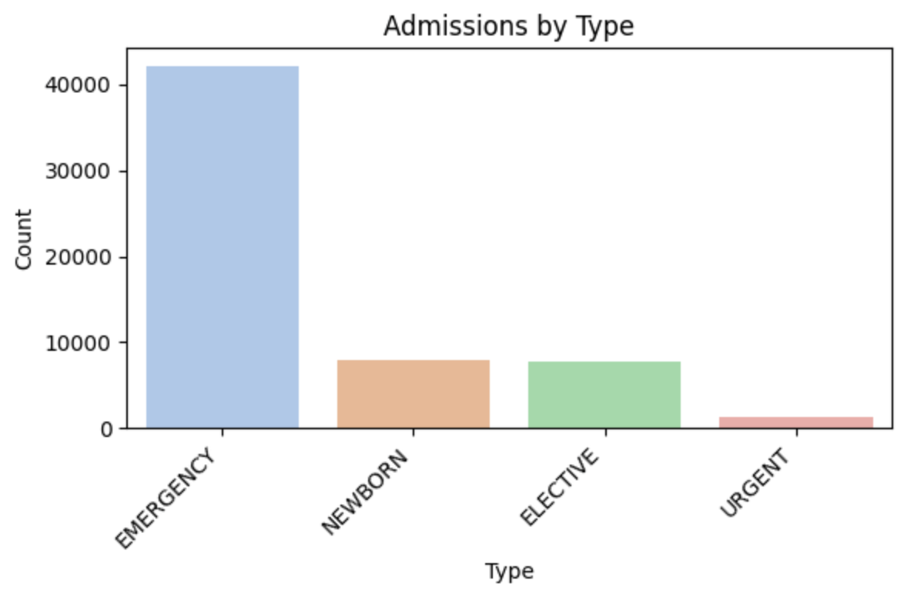
Plot 2 – Admissions by Type

Slide 6
Plot 2 – Admissions by Type
For this chart, we use the ADMISSIONS.csv file.
First, we count how many admissions fall under each type, sorting types by descending frequency so the most common ones are listed first.
Then, we plot a bar chart of admissions for each type.
This chart shows patients’ admission pathway through the hospital.

Slide 7
Plot 2 – Admissions by Type
plt.figure(figsize=(6,4))
sns.countplot(
x='ADMISSION_TYPE',
data=admissions,
order=admissions['ADMISSION_TYPE'].value_counts().index,
palette='pastel'
)
plt.title('Admissions by Type')
plt.xlabel('Type')
plt.ylabel('Count')
plt.xticks(rotation=45, ha='right')
plt.tight_layout()
plt.show()

Slide 8

Plot 3 – Caregivers by Role

Slide 9
Plot 3 – Caregivers by Role
For this chart, we use the CAREGIVERS.csv file.
First, we compute the percentage of records for each role (e.g. MD for physicians).
Next, we plot a pie chart which displays the percentage of each role.
This chart shows hospital staffing from a high-level.

Slide 10
Plot 3 – Caregivers by Role
care_counts = caregivers['LABEL'].value_counts().reset_index()
care_counts.columns = ['role', 'count']
fig3 = px.pie(
care_counts,
names='role',
values='count',
title='Caregivers by Role',
color_discrete_sequence=px.colors.sequential.Plasma
)
fig3.update_traces(textposition='inside', textinfo='percent+label')
fig3.show()

Slide 11
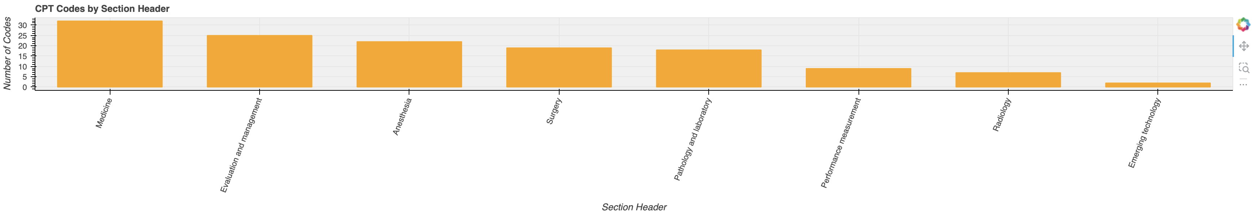
Plot 4 – CPT Codes by Section Header

Slide 12
Plot 4 – CPT Codes by Section Header
For this chart, we use the D_CPT.csv file.
First, we count how many CPT codes fall under each section header (e.g. evaluation), preserving the natural order of the headers.
Next, we create a bar chart displaying the counts of the CPT codes for each section header.
This chart shows section headers with the most CPT codes.

Slide 13
Plot 4 – CPT Codes by Section Header
section_counts = d_cpt['SECTIONHEADER'].value_counts().reset_index()
section_counts.columns = ['section', 'count']
source_cpt = ColumnDataSource(section_counts)
p2 = figure(
x_range=section_counts['section'].tolist(),
title='CPT Codes by Section Header',
height=300,
sizing_mode='stretch_width',
background_fill_color='#f0f0f0'
)
p2.vbar(x='section', top='count', width=0.7, source=source_cpt, color='orange')
p2.xaxis.major_label_orientation = 1.2
p2.xaxis.axis_label = 'Section Header'
p2.yaxis.axis_label = 'Number of Codes'
show(p2)

Slide 14
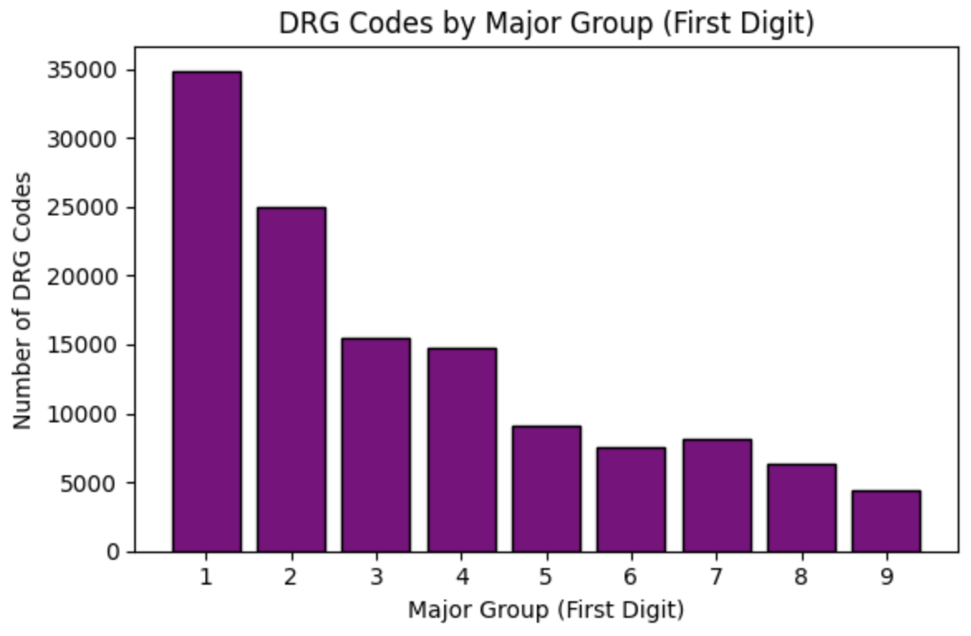
Plot 5 – DRG Codes by Major Group

Slide 15
Plot 5 – DRG Codes by Major Group
For this chart, we use the DRGCODES.csv file.
First, we count how many of the DRG codes belong to each major group.
Then, we plot a bar chart with one bar representing each major code’s count of DRG codes.
This chart reveals which major groups have the most DRG codes.

Slide 16
Plot 5 – DRG Codes by Major Group
drg['major_group'] = drg['DRG_CODE'].astype(str).str[0]
drg_counts = drg['major_group'].value_counts().sort_index()
plt.figure(figsize=(6,4))
plt.bar(drg_counts.index, drg_counts.values, color='purple', edgecolor='black')
plt.title('DRG Codes by Major Group (First Digit)')
plt.xlabel('Major Group (First Digit)')
plt.ylabel('Number of DRG Codes')
plt.tight_layout()
plt.show()

